Slide 1
Less redos, more profits
Denise Capretta, COMT, LDO, ABOC, NCLEC

Slide 2
Key Benefits
Reduce cost and boost revenue.
Increase available chair time for new patients.
Improve patient satisfaction.
Training and education for office staff.
Attract and retain patients.
Notes:
Let’s look at some of the key benefits of addressing redos in your practice.

Slide 3
THE AVERAGE DOCTOR REDO RATE OF AN EYE CARE PRACTICE IN THE US.
DO YOU KNOW YOURS?
Notes:
If your redo rate is higher than the national average, you’re doubling your expenses, and losing the opportunity to generate new-patient revenue. This could also lead to lower patient satisfaction.
If you have a 10% or higher redo rate, 1 out of every 10 patients will be leaving your office unhappy after the first visit.

Slide 4
Let’s talk numbers
$300
Average new-patient revenue lost due to redo patient visits.
$5K
OR MORE
Average annual staff cost for submitting redos.
9
Average number of doctor redos per month in a practice
Notes:
Every redo you submit takes time away from potential new patients. That means you could be missing out on an average of $300 for each new eye exam. In fact, the average eye care practice, has 9 redos per month and, based on 2,000 exams per year, loses nearly $5,000 in labor costs due to redos.
Just imagine what negative impact this has on the patient experience in your practice.

Slide 5
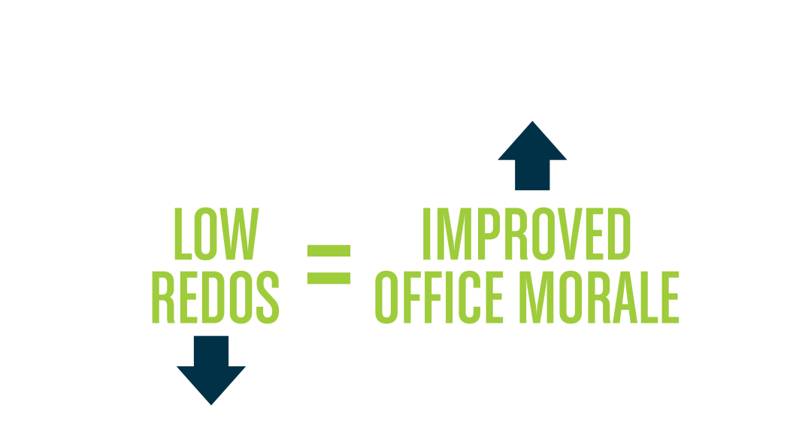
The impact on your staff
Notes:
High redo rate means that you spend a lot of time explaining or apologizing to patients! This has a huge impact on your office morale and your staff motivation.
Office mora

Slide 6
Managing common redos

Slide 7
Common redos
Rx Change
Lens Style
Frame Change
Seg/fitting Height
PD Measurement
Material Change
AR Coating
Tinting

Slide 8
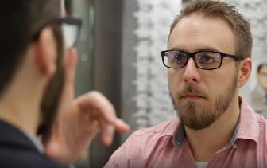
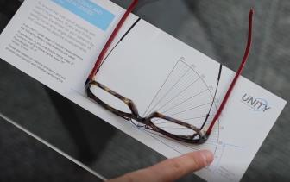
Verify & measure
Prescription in lensometer
Distance PD and seg height
Distance and near vision
Size of reading area in frame
Back-vertex, panto and face form wrap
Notes:
Verify that the eyewear matches the doctor’s prescription by comparing lensometry measurements to the original prescription and comparing that to ANSI standards.
Check the distance PD and vertical position of the lens in the frame, also called seg height, then record the results and compare to the original order. Once you have taken the time to re-establish the progressive layout, apply a verification mask and check for proper alignment with the patient. Remember to adjust your position to be directly in front of the patient to avoid parallax error.
Now would be a good time to ask more specific questions to see where exactly the patient is having the most trouble, in the distance, or up close.
If their distance vision is blurry, be certain the fitting cross isn't too high. Or, it might be the patient is simply tilting their head back too far, changing their gaze through the intermediate portion of the lens instead of the wide distance area.
If the reading area seems too narrow, double check that the fitting crosses are not fit too low, too wide or narrow, or off axis.
Ensure that the lens and frame provide enough room for the reading area in the bottom of the lens.
Note the fit of the eyewear as it relates to back vertex distance, appropriate pantoscopic tilt, and general face form of the final product. Is the frame fit correctly according to your original measurements?
Pantoscopic Tilt should be around 5-10 degrees.
Face form will depend on the Rx and overall frame fit. It should be positive face form and not too flat.
We don't want them too close, so that the wearer can't blink, but the closer a progressive lens fits the wider the reading area, the less noticeable all that unwanted blur becomes.
For more tips on how to properly align the frame, visit our UUniversity chapter called “Dispensing – Frame Adjustment”

Slide 9
Check medical history
Vision without and with cataracts
Vision with glaucoma
Vision without and with diabetic retinopathy
Notes:
Perhaps the patient’s chart might indicate that the patient is corrected to 20/40. Not all patients can receive 20/20 vision due to cataracts, glaucoma, diabetic retinopathy, or a number of other medical issues or problems.
Without getting into an awkward medical conversation with the patient in the front office, you may have to let them know 20/20 vision cannot be achieved.
Remember: a delicate conversation of this nature is significantly more effective when communicated before eyewear is even ordered.

Slide 10
Educate patient
First-time progressive wearer?
Dramatic change in Rx?
Different frame style and size?
Lifestyle needs?
Office worker or tennis player?
Notes:
Always remember to educate your patients on the product they’ve received. For example, if a patient is a first-time progressive wearer, has a dramatic change in prescription or picked a very different frame from their old frame, it may take a few days to get used to them.
Ask the patient, again, specifically, what they are using the glasses for. Perhaps they are spending the whole day in a cube doing close-up work and would benefit from a specialty pair of room distance glasses, alleviating the crick in their neck from trying to find the sweet spot for intermediate range in their progressive lenses.

Slide 11
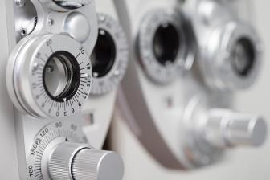
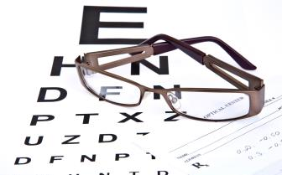
Handling outside rx
Verify it!
Notes:
If a patient comes in with an outside prescription, take the time to verify it. Dial it into the Phoropter, and make sure the patient can see clearly. Your patient will feel more confident that you took this important step, and it sets you apart from the competition. The obligation to correct or redo the lenses if the refraction is inaccurate falls on the practice filling it. So there is nothing to lose.

Slide 12
Refer to a specialist
A second opinion is always a good course of action.
Notes:
If you’ve done two remakes for a patient and they call back again complaining of poor vision, refer them to a specialist. And use the word specialist when talking with the patient. A referral is in the patient’s best interest. Maybe you aren't clicking, maybe there is a communication problem.
Or maybe an undiagnosed medical problem, such as diabetes, is causing problems with the prescription.
A second opinion is always a good course of action. By referring a patient to a specialist, you begin to draw the situation to a conclusion. The patient hopefully will find some help for their problem. If the problem is in the patient’s head, the patient is likely to realize this if the specialist informs them that nothing is wrong.

Slide 13
Schedule & follow-up
Mark your calendar.
Check in with your patient.
Regain their confidence.
Notes:
Whatever strategy you applied, and however the outcome, mark your calendar a week or two out, to follow up: call the patient and see how they are doing. Investing a moment to close the loop by making the call will build your professional relationship with each patient and separate you from your competition. And it will for sure regain their confidence in you to ensure the patient will come back to see YOU when it is time for another eye exam.

Slide 14
Your redo policy
Unlimited remakes?
One free remake?
50% off remakes?
Have a written policy in place.
Notes:
Establish a clearly articulated remake policy in your practice. The policy can go from unlimited remakes (total patient satisfaction) to limited remakes, for instance one free remake within 30 days or similar. Most likely, patients will come in sooner. Have the policy in writing to protect yourself from the one patient who may abuse your services. It is up to you how strictly you will enforce them.

Slide 15
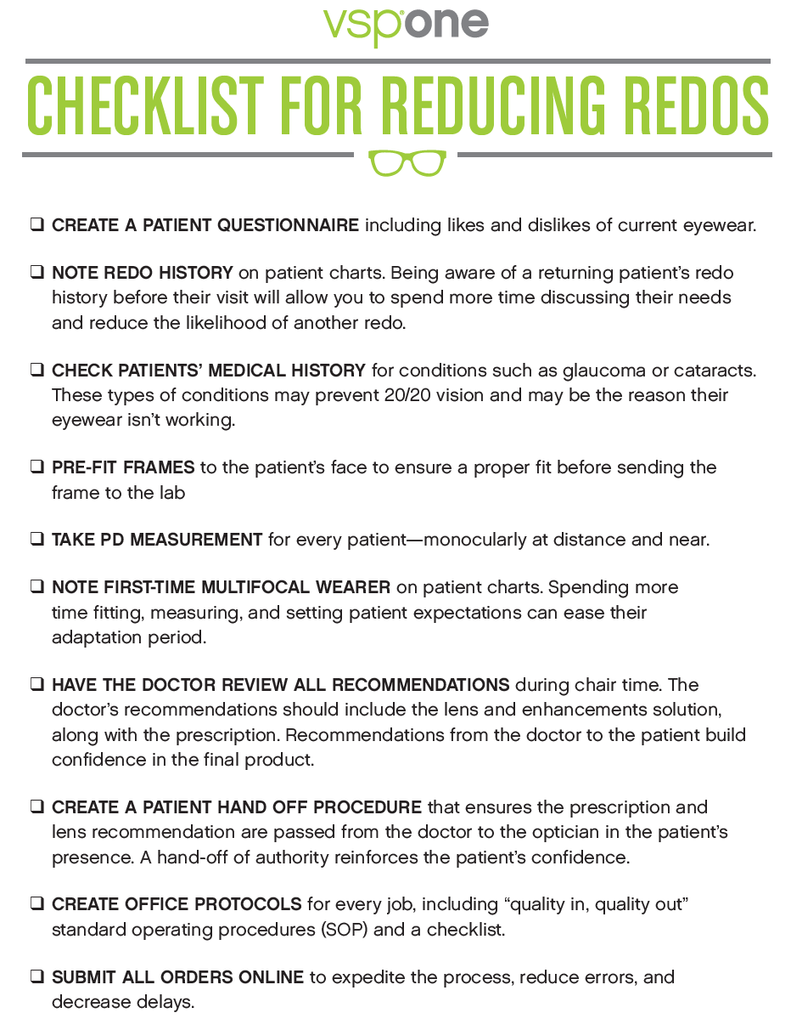
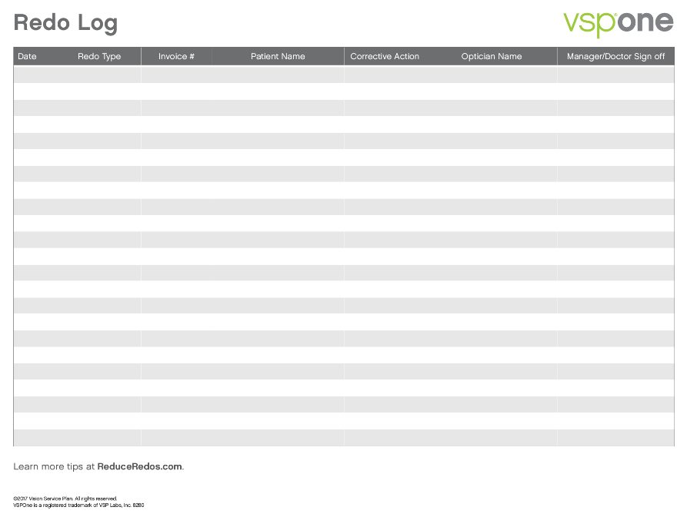
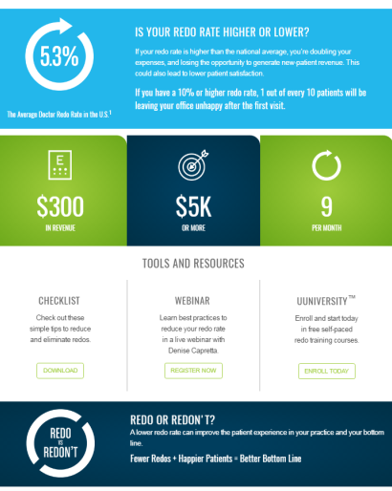
Notes:
The one-stop-shop for this topic: our web page with all important tools for you to use – www.reduceredos.com.
And last but not least, you have a great resource with your VSPOne Business Consultant. Following this webinar, your business consultant would love to meet with you and your staff to look at your specific situation. How high is your redo rate and why is it where it is? What are the most common redos that happen in your practice? Our business consultant will identify those with you and then work with your staff to put measures in place to reduce some of them.

Slide 16
Schedule an in-office training with a vsp optics group representative

Slide 17
Thank you
©2017 Vision Service Plan. All rights reserved.
VSP, Unity, sunsync and otto are all registered trademarks, and TechShield is a trademark, of Vision Service Plan. All other brands or marks are the property of their respective owners.

