Slide 1
Blue light: separating science from speculation
Alan Burt, COPE, ABO

Slide 2
THE EVOLUTION OF ILLUMINATION
THE EVOLUTION OF ILLUMINATION
In the last decade, we have undergone the biggest change in the way we light and see our world in the history of mankind.

Slide 3
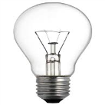
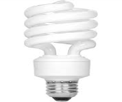
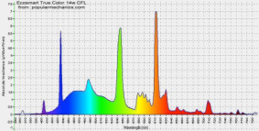
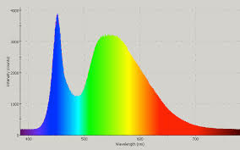
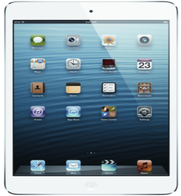
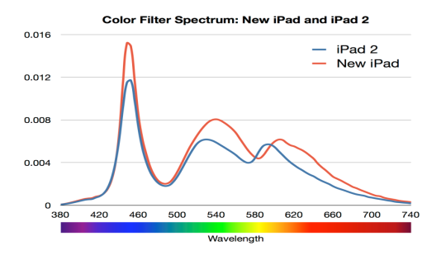
TRADITIONAL VS. MODERN LIGHT SOURCES
TRADITIONAL VS. MODERN LIGHT SOURCES
Both the quantity and intensity of blue light exposure have grown
1/2
1/4

Slide 4
The Scientific Facts
Blue light exposure from digital devices:
Clinically Proven
Causation
Product Efficacy

Slide 5
The Scientific Facts
Sleep Disruption & Blue Light
Exposure to blue light at night is clinically proven to disrupt sleep.
There are no lens products on the market that are clinically proven to improve sleep.*

Slide 6
The Scientific Facts
AMD & Blue Light
There are no current studies that link digital device screen usage to AMD
There are no lens products on the market that are clinically proven to reduce risk of developing AMD

Slide 7
The Scientific Facts
Digital Eye Strain
The most scientifically valid and clinically appropriate positioning for blue light attenuating lens products is to help alleviate the symptoms of digital eye strain.

Slide 8
The Scientific Facts
Blue light exposure from digital devices:
Clinically Proven
Causation
Product Efficacy

Slide 9
Digital Eye Strain
Blue light is
defocused in front
of the retina
Green light
in focus
on macula
Red light is
defocused behind
the retina
Visible
Light
-1.00
Plano
+.50
Chromatic aberration

Slide 10
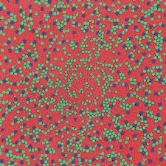
BLUE LIGHT IS NOT WELL PROCESSED
MACULAR CONE
PHOTORECEPTORS
RED 65%
GREEN 33%
BLUE 2%
FOVEA IS DEVOID
OF BLUE CONE
PHOTORECEPTORS

Slide 11
BLUE LIGHT IS NOT WELL PROCESSED
Blue Cones:
Peak light sensitivity 445nm
More light sensitive than red or green cones, but not enough to overcome their disadvantage in number
The visual perception of intensely blue objects is less distinct than the perception of red and green objects
Blue sensitivity of our final visual perception is comparable to that of red and green, suggesting a "blue amplifier" somewhere in the visual processing system
http://hyperphysics.phy-astr.gsu.edu/hbase/vision/rodcone.html#c3b Georgia State University

Slide 12
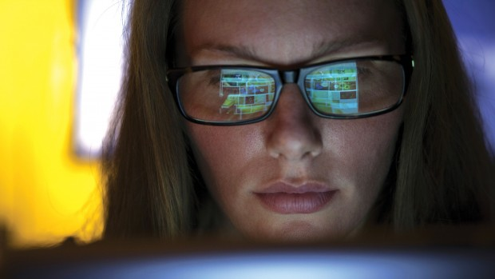
BLUE LIGHT AND DIGITAL EYE STRAIN
Glare
Digital Eye Strain

Slide 13
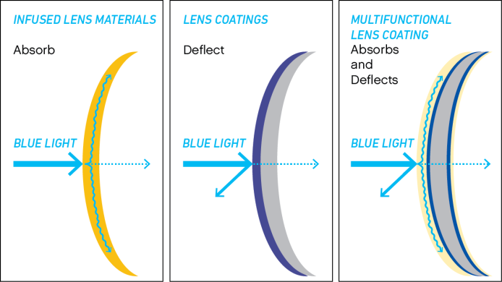
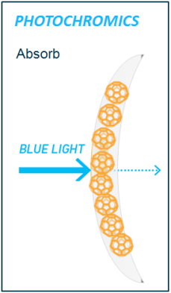
BLUE LIGHT REDUCING LENS PRODUCTS

Slide 14
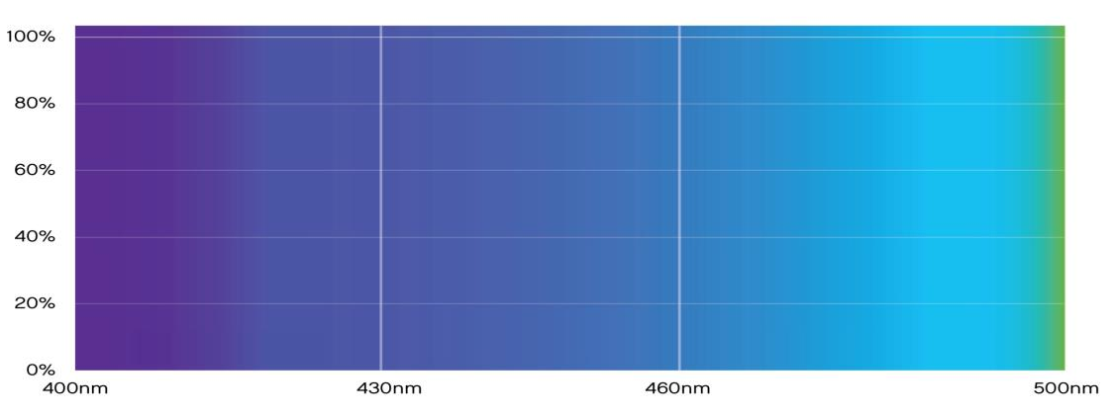
UNDERSTANDING SPECTRAL TRANSMITTANCE
To understand how a lens attenuates light, we must examine spectral characteristics.
0%
ATTENUATION CAN BE ACHIEVED THROUGH REFLECTANCE AND/OR ABSORPTION
50% ATTENUATION
20%
40%
% TRANSMITTANCE
% ATTENUATION
60%
50% TRANSMITTANCE
80%
100%
WAVELENGTH

Slide 15
UNDERSTANDING SPECTRAL TRANSMITTANCE
A high-quality AR coating will allow 98%+ transmittance of light.
0%
CONVENTIONAL AR COATING
20%
40%
% TRANSMITTANCE
% ATTENUATION
60%
Conventional AR coatings have
no effect on blue light
80%
100%
WAVELENGTH

Slide 16
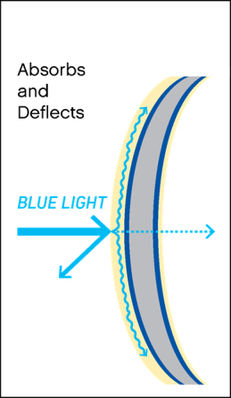
MULTIFUNCTIONAL COATINGS
Multi-layer thin film coatings with rare earth
compounds and minerals both reflect and
absorb Blue Light
Significant effect on shortest blue light range
Cosmetic appearance of lens moderated due to
combination of absorptive and reflective
characteristics
Selectively attenuates blue light on a spectral curve that induces lowest blue light transmission
in range associated with visual strain and fatigue.

Slide 17
TechShield™ Blue
TechShield Blue reduces the blue light associated with digital eye strain while allowing natural transmittance of light across the rest of the visible light spectrum.
0%
CONVENTIONAL AR COATING
20%
TECHSHIELD BLUE
40%
% TRANSMITTANCE
% ATTENUATION
60%
80%
100%
WAVELENGTH

Slide 18
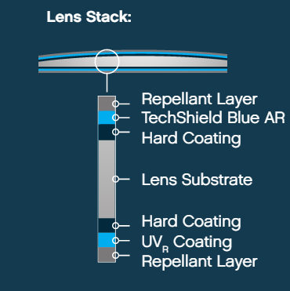
TechShield Blue
D category AR coating
Absorbs and reflects blue light
Blocks UV
Minimal backside reflectance
UV_{R} standard
Super oleophobic
Hydrophobic
Resists scratching
Available on all materials and all designs*
Notes:
*unless otherwise specified by manufacturer

Slide 19
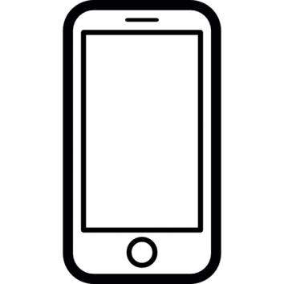
INVERSE SQUARE LAW
How does harmful light from the sun compare to device usage?

Slide 20
SUNLIGHT & BLUE LIGHT EXPOSURE

Slide 21
INVERSE SQUARE LAW
16 INCHES
8 INCHES
4X
1
INTENSITY =
DISTANCE²
At 16” a smartphone is 15% as bright as sunlight.
At 8” a smartphone is 50% as bright as sunlight.

Slide 22
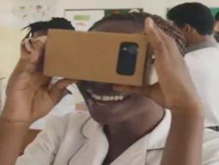
INVERSE SQUARE LAW
16 INCHES
64X
2 INCHES
1
INTENSITY =
DISTANCE²
With an AR/VR headset, a smartphone at 2” is 90% as bright as sunlight.

Slide 23
INVERSE SQUARE LAW
How does harmful light from the sun compare to device usage?
EMITS UV & BLUE LIGHT
EMITS BLUE LIGHT

Slide 24
Photochromic Lens Function
SunSync® Light-Reactive Lenses reduce blue light by absorption.
Photochromic nanoparticles retain absorptive properties in clear state.
These absorptive properties mean sunsync lenses reduce blue light transmittance in their clear state, where no UV from sunlight is present.

Slide 25
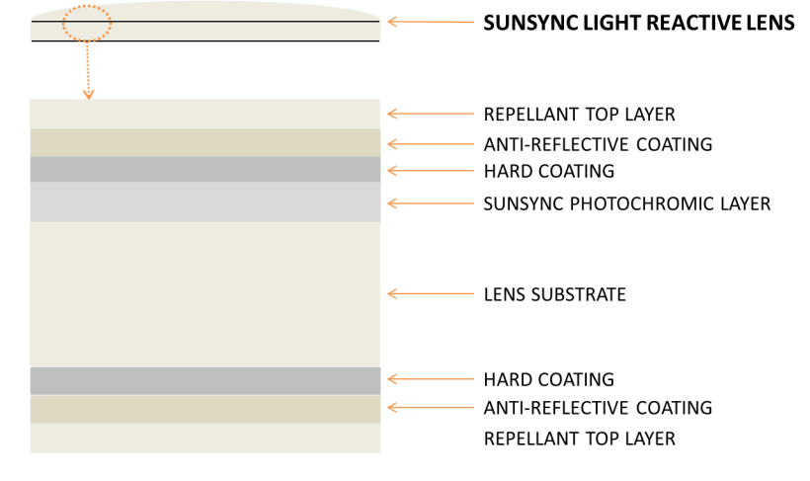
Sunsync light-reactive lenses

Slide 26
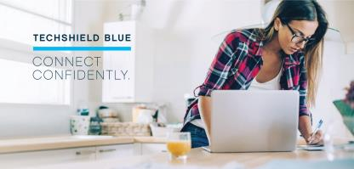
When to choose What
Indoor and outdoor
exposure to blue light
Mostly Indoor use or high
amounts of screen-time

Slide 27
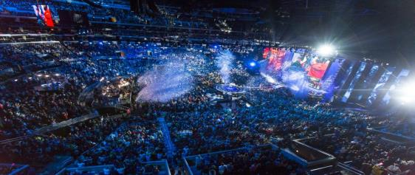
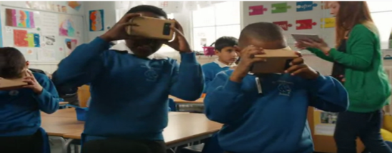
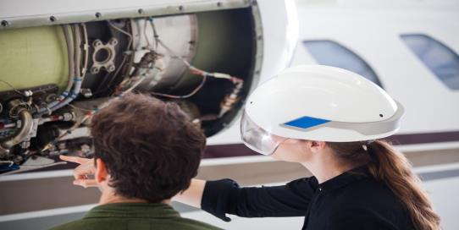
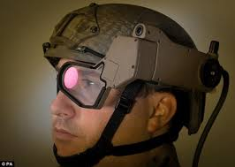
INVERSE SQUARE LAW
“I regard [augmented reality] as a big idea like the smartphone. The smartphone is for everyone, we don't have to think the iPhone is about a certain demographic, or country or vertical market: it’s for everyone. I think AR is that big, it’s huge.”
- Tim Cook, CEO Apple

Slide 28
Schedule an in-office training with a vsp optics group representative

Slide 29
thank you
©2017 Vision Service Plan. All rights reserved.
VSP and otto are registered trademarks of Vision Service Plan. Unity and SunSync are registered trademarks, and TechShield is a trademark of Plexus Optix, Inc. VSPOne is a registered trademark of VSP Labs, Inc. All other brands or marks are the property of their respective owners.

